Slide 1

A lightweight deep learning model to detect lesions at early stage in stomach
Research Guide:
Regnum with names
SCOPEVIT-AP University.

Slide 2
Agenda
Introduction
Objectives
Literature survey
Inference
Proposed solutions
References

Slide 3
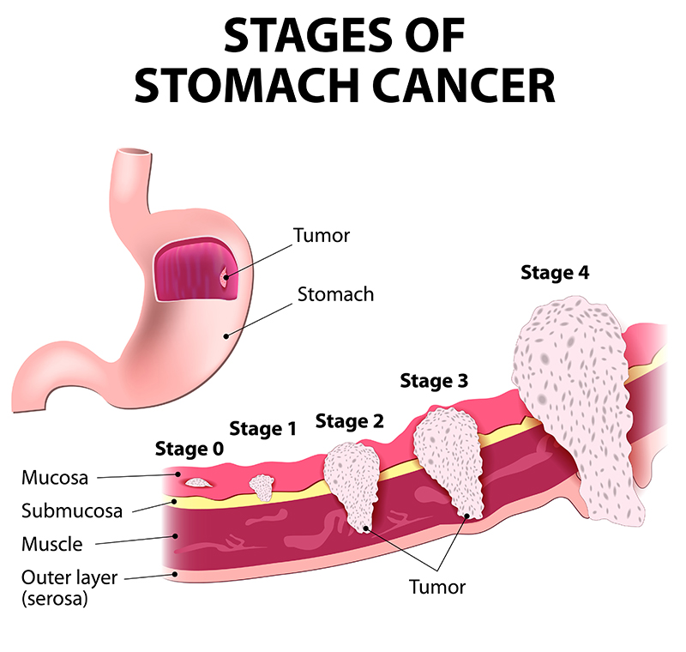
Introduction

Slide 4
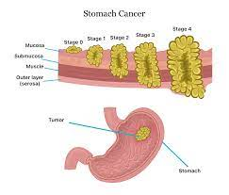
STOMACH CANCER

Slide 5
Objective
To identify lesions by developing robust model
….
….

Slide 6
Literature Survey

Slide 7
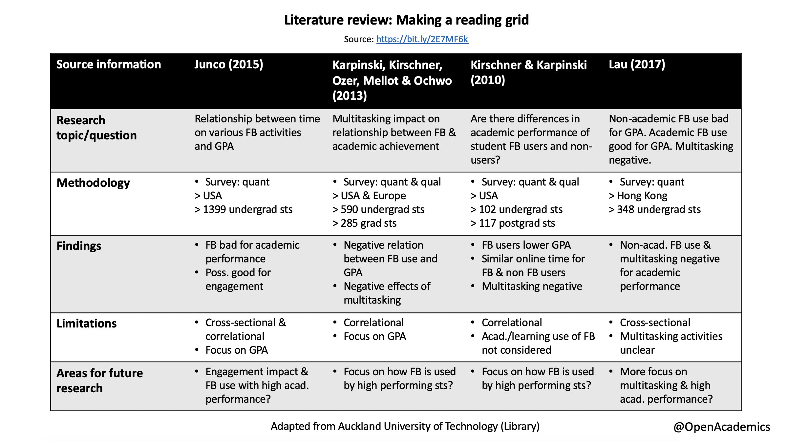

Slide 8

Problem Statement
To develop a model that could identify lesion at the early stages

Slide 9
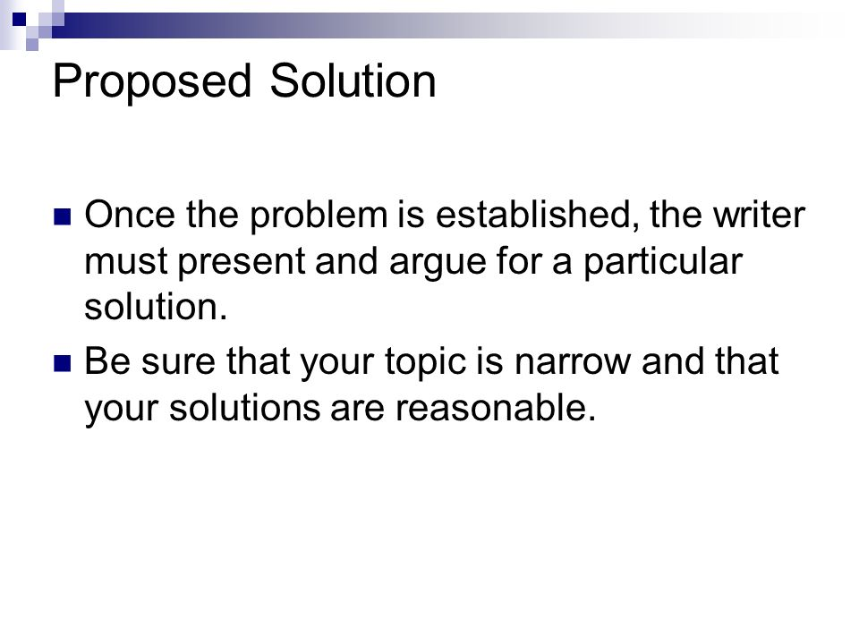
Proposed Solution
Distributed Visual Feature Extraction for Medical Image Segmentation
A novel deep transfer learning model which should identify the benign or malignant

Slide 10
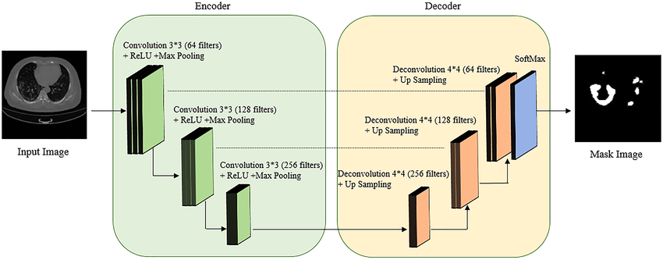
Procedure for the solution

Slide 11
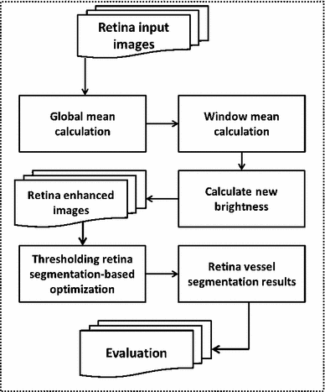
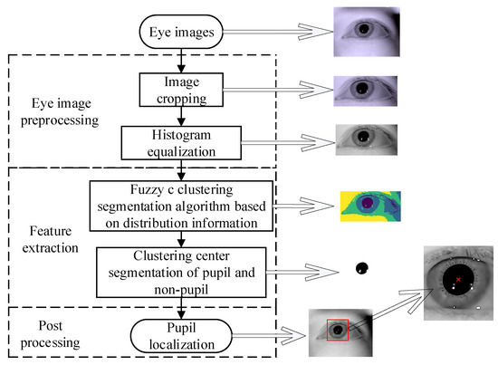

Slide 12
Algorithm in steps

Slide 13
Dataset description
Training
Testing
Validation…

Slide 14
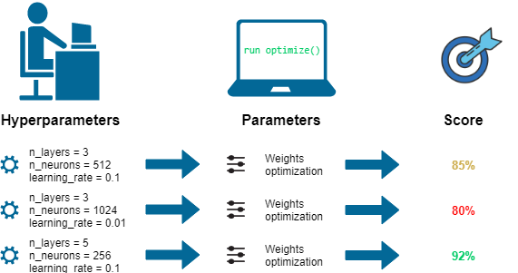
Hyperparameters (if applicable)

Slide 15
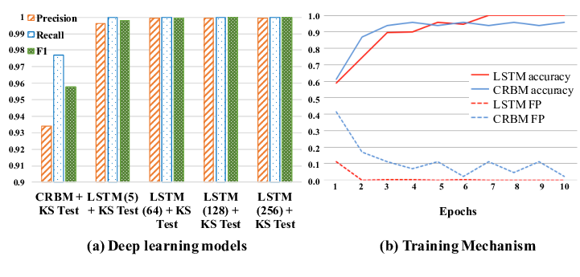

Slide 16
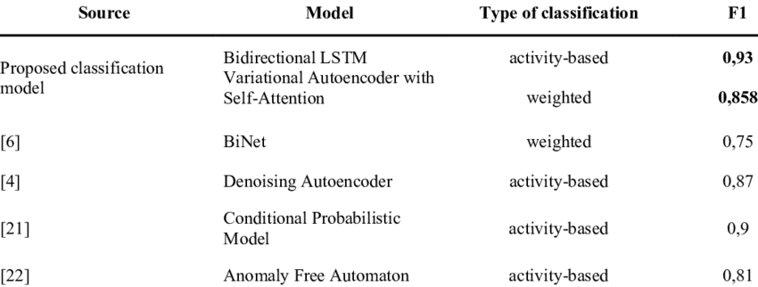
Comparison of the current research with Other Different Approaches

Slide 17
Conclusion(do not copy and paste)
Deep learning combined with spectral-spatial classification methods based on 120 fresh tissues samples that had a confirmed diagnosis by histopathological examinations was used to automatically identify and extract the “spectral + spatial” features to construct an early diagnosis model of gastric cancer. The model results showed that the overall accuracy for the nonprecancerous lesion, precancerous lesion, and gastric cancer groups was 96.5% with specificities of 96.0%, 97.3%, and 96.7% and sensitivities of 97.0%, 96.3%, and 96.6%, respectively.

Slide 18
References
S. S. Kar and S. P. Maity, "Automatic Detection of Retinal Lesions for Screening of Diabetic Retinopathy," in IEEE Transactions on Biomedical Engineering, vol. 65, no. 3, pp. 608-618, March 2018, doi: 10.1109/TBME.2017.2707578.
Z. Fan et al., "Optic Disk Detection in Fundus Image Based on Structured Learning," in IEEE Journal of Biomedical and Health Informatics, vol. 22, no. 1, pp. 224-234, Jan. 2018, doi: 10.1109/JBHI.2017.2723678.
A. Imran, J. Li, Y. Pei, J. Yang and Q. Wang, "Comparative Analysis of Vessel Segmentation Techniques in Retinal Images," in IEEE Access, vol. 7, pp. 114862-114887, 2019, doi: 10.1109/ACCESS.2019.2935912.

Slide 19
THANK YOU

